Slide 1
Introducing Bootstrap
Introducing the Twitter Bootstrap framework for building a clean, intuitive and responsive web application.

Slide 2
Learning Outcome
After this lesson you will know about what a responsive web site is.
You will be able to build a web site based on bootstrap.
You will be able to design a user interface, that will work on both a desktop and on a mobile device.
You will know about the elements of Bootstrap

Slide 3
Agenda
Introduction to Bootstrap
What is a responsive website?
Creating content for different sizes of devices
Bootstrap grid - basics
Exercise

Slide 4
Introducing Bootstrap
Bootstrap

Slide 5
Introducing Bootstrap
Bootstrap was developed by Mark Otto and Jacob Thornton at Twitter, and released as an open source product in August 2011 on GitHub.
In June 2014 Bootstrap was the No.1 project on GitHub!
There are two ways to start using Bootstrap on your own web site.
Download Bootstrap from getbootstrap.com
Use the NuGet Package in visual studio
Include Bootstrap from a CDN

Slide 6
Introducing Bootstrap
Bootstrap is the most popular HTML, CSS, and JavaScript framework for developing responsive, mobile-first web sites.
Bootstrap is completely free to download and use!
Download it or use a NuGet package in visual studio

Slide 7
Introducing Bootstrap
Bootstrap is a free front-end framework for faster and easier web development
Bootstrap includes HTML and CSS based design templates for typography, forms, buttons, tables, navigation, modals, image carousels and many other, as well as optional JavaScript plugins
Bootstrap also gives you the ability to easily create responsive designs

Slide 8
Responsive websites
Bootstrap

Slide 9
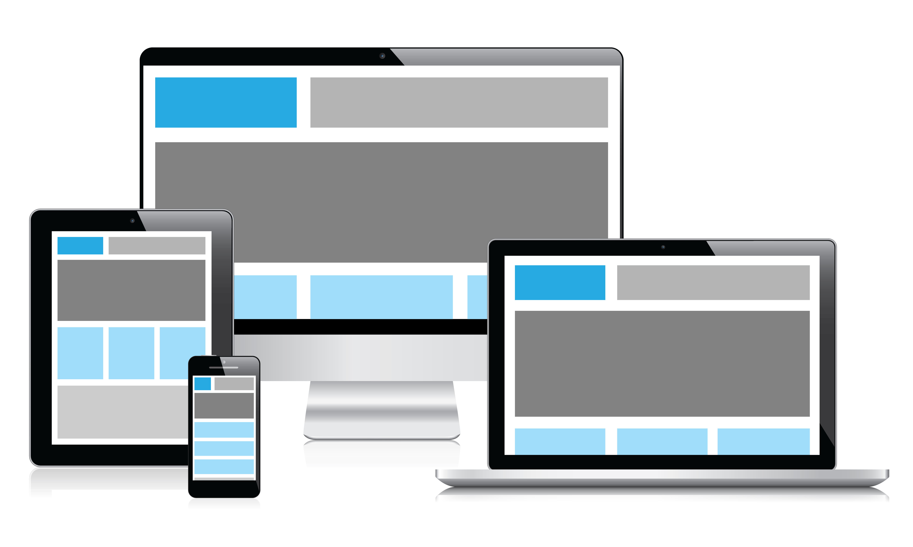
Responsive Websites
Responsive web design is about creating web sites which automatically adjust themselves to look good on all devices, from small phones to large desktops.

Slide 10
Matching different devices
Bootstrap

Slide 11
Matching different devices
A website doesnt necessarily know which client visits them.
All it know is the user agent (that might reveal that its Android og Windows).
A website only know about the width and height of the viewport
The viewport is the user's visible area of a web page.
The viewport varies with the device, and will be smaller on a mobile phone than on a computer screen.

Slide 12
Matching different devices
The browser only know the viewport – that is the height and width of the device
The browser now has the responsibility of resizing the content to the browser viewport.
For this purpose we use media queries (@media)
The media queries will typically have rules that fits each device.
That means that the CSS will have different areas where the styles for a particular ”device” is managed.

Slide 13
Matching different devices
/* Extra small devices (phones, less than 768px) */
/* No media query since this is the default in Bootstrap */
/* Small devices (tablets, 768px and up) */
@media (min-width: @screen-sm-min) { ... }
/* Medium devices (desktops, 992px and up) */
@media (min-width: @screen-md-min) { ... }
/* Large devices (large desktops, 1200px and up) */
@media (min-width: @screen-lg-min) { ... }

Slide 14
Bootstrap grid - basics
Bootstrap

Slide 15
Bootstrap grid - basics
A bootstrap page is build within one or more containers. A container can be fixed or fluid
The fixed has fixed size and centered, the fluid is 100% width.
The general bootstrap grid is build on row and columns.
Bootstrap's grid system allows up to 12 columns across the page.
A layout element may span multiple columns.
A layout element may offset a number of columns.

Slide 16
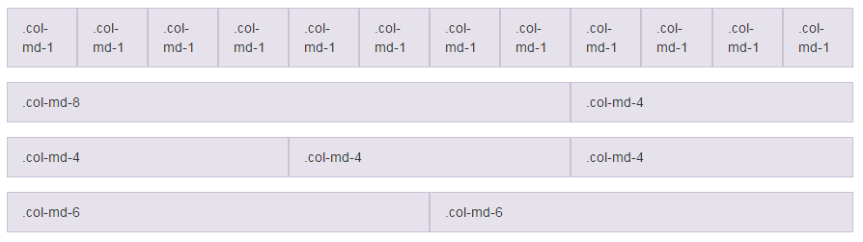
Bootstrap grid - basics

Slide 17
Bootstrap grid - basics
The layout may differ for each of the different sizes. This makes it possible for the developer to create different experiences for each device.
Demo: gridtest.html
Try resizing the browser to simulate a smaller device

Slide 18
Exercises
Bootstrap

Slide 19
Centisoft
Look at a couple of websites, do they use bootstrap?
Can you identify the row and columns?
Modify your HTML interface to use bootstrap
Use CDN if you dont want to download it
Test it on different devices
Google chrome can do this in the developer tools

Slide 20
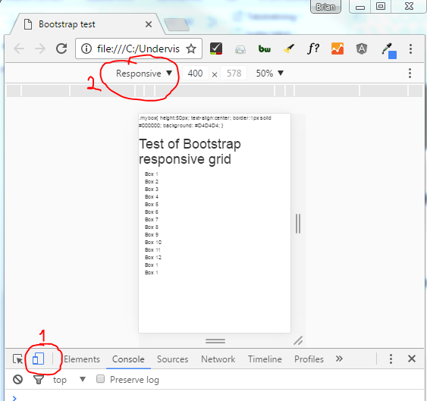
Google Chrome to test Mobile

